Slide 1
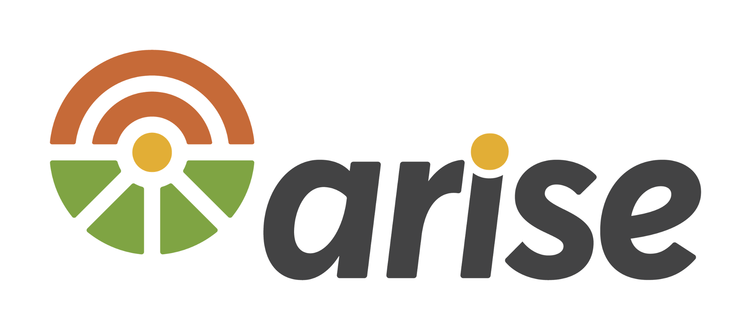

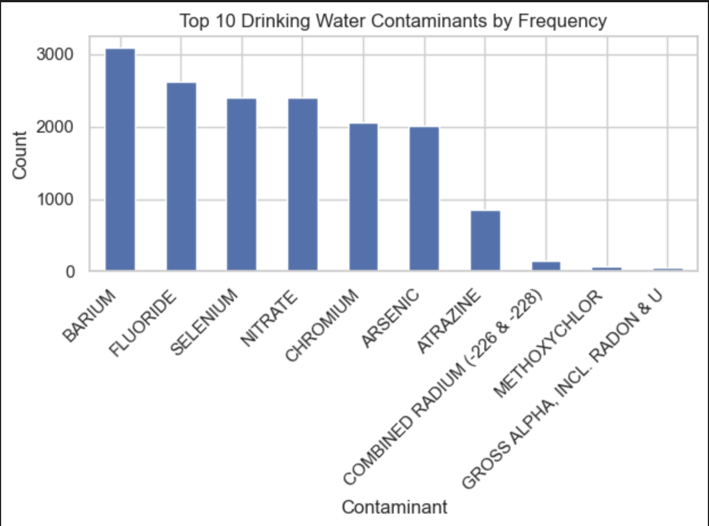
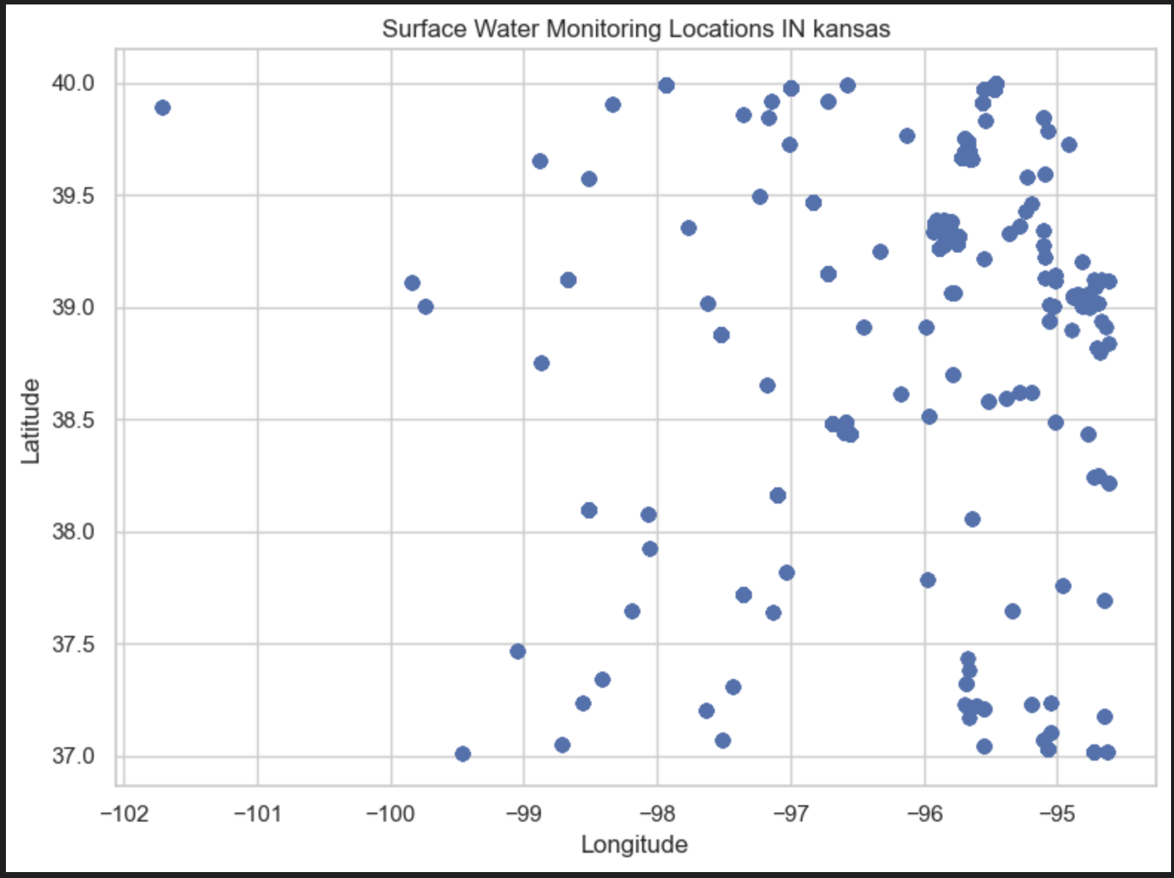
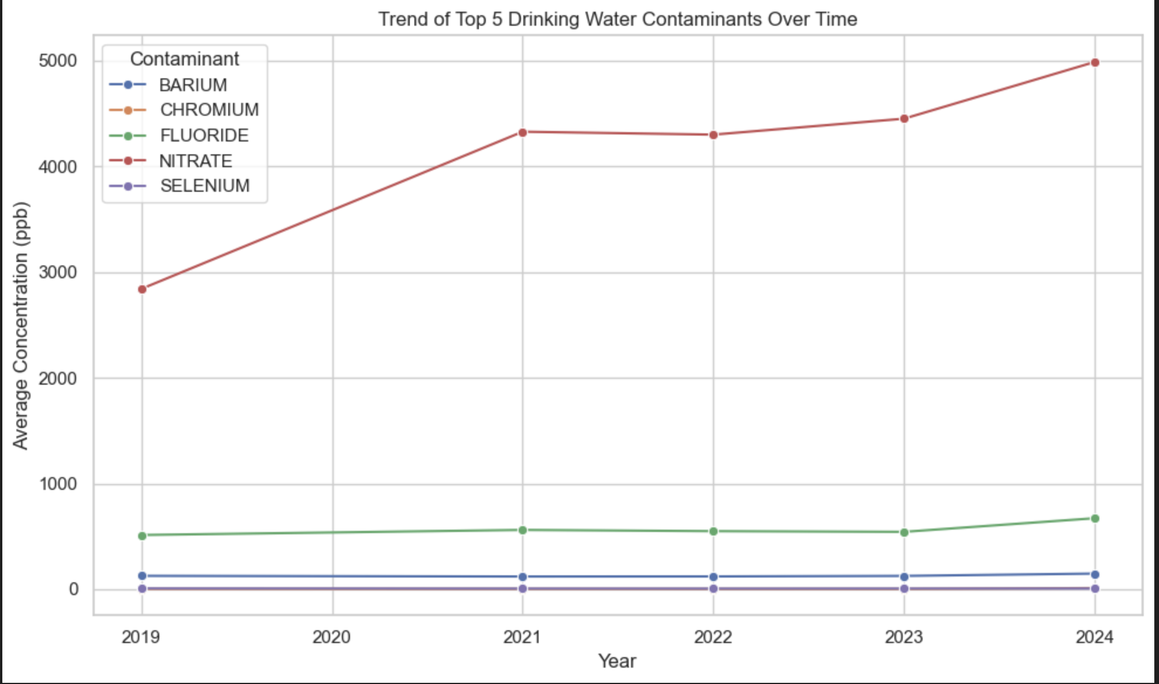
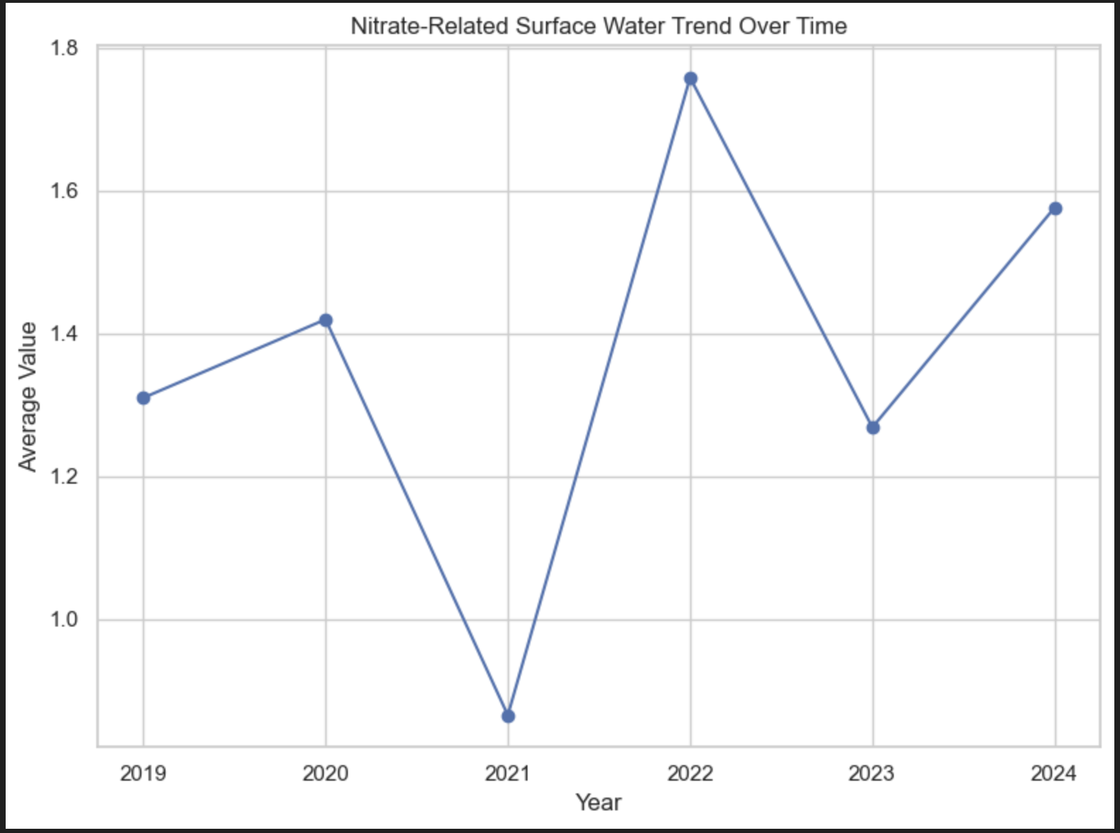
Surface Water and Drinking Water Contaminants in Kansas
Team 10, Wichita State University - CS 896 – Data Science Capstone
Introduction
Results
Surface Water Analysis
Surface water monitoring locations are distributed across Kansas, covering approximately 164 unique monitoring sites.
This spatial distribution allows for geographic exploration of water quality patterns.
This project analyzes water quality conditions in Kansas to understand how contamination in surface water may affect community drinking water systems. The project was developed in collaboration with the Kansas Data Science Consortium (KDSC) and community partner ARISE.
The main goal is to identify important contaminants in drinking water and examine whether similar patterns appear in surface water data. Due to missing geographic identifiers in the drinking water dataset, a direct linkage between surface water and drinking water systems was not possible.
Instead, the project focuses on two components:
Statistical analysis of drinking water contaminants
Spatial and temporal analysis of surface water measurements
Drinking Water Analysis
Barium, Fluoride, Selenium, Nitrate, and Chromium are the most frequently reported contaminants in drinking water systems.
Among these, Nitrate stands out clearly, with concentration levels significantly higher than all other contaminants.
Nitrate concentrations show a noticeable increasing trend over time, rising from around 2800 ppb in 2019 to nearly 5000 ppb in 2024.
Other contaminants such as Barium, Chromium, Fluoride, and Selenium remain relatively stable across years with only minor fluctuations.
Nitrate-related surface water measurements show clear variation across locations, with no single dominant hotspot.
Temporal analysis shows that nitrate-related values fluctuate over time:
Lowest observed around 2021 (~0.86)
Peak around 2022 (~1.75)
Moderate levels in other years
Data Source & Preparation
Two datasets were used:
Drinking Water Dataset (CCR)
Municipal water system reports
Cleaned and standardized to ppb
Non-numeric values (e.g., “<0.5”, “ND”) converted
Surface Water Dataset (WQP)
Water Quality Portal data
Includes latitude and longitude
Cleaned by removing missing values and converting numeric fields
Final datasets:
Drinking water: ~16,000 observations
Surface water: ~17,000 observations across ~164 locations
Discussion
The results show that contaminant behavior varies across substances, with nitrate standing out as the most significant contaminant in drinking water.
Surface water analysis indicates that nitrate-related measurements are distributed across multiple locations and fluctuate over time, suggesting that contamination is not concentrated in a single hotspot.
A key limitation of the project is the lack of geographic identifiers in the drinking water dataset, which prevents direct linkage with surface water monitoring sites.
Future work could include integrating watershed data or obtaining linked datasets to better understand how surface water impacts drinking water systems.
Exceedance Analysis
Exceedance analysis shows that Atrazine has the highest exceedance rate (~6%), followed by Nitrate (~3–4%).
Some contaminants initially appeared to have very high exceedance rates, but these were based on very small sample sizes.
After filtering for contaminants with sufficient observations, the results show that exceedance is not solely driven by high concentration levels, but also by regulatory thresholds and variability.

